Slide 1

DEPARTMENT OF ARTIFICIAL INTELLIGENCE AND DATA SCIENCE
Project name : Smart Parking
Team name : project_224780_Team_2
Team members :
HARSHITHA SHIVANI T(113321243014)
ITHA VAISHNAVI SANJUKTHA(113321243015)
JEROMEY A(113321243016)
KAMIREDDY BHAVANI(113321243017)
RAVURU VARSHITHA REDDY(113321243041)

Slide 2
Introduction:
In an era of rapid urbanization, the increasing number of vehicles on the road has led to a pressing issue - finding parking spaces efficiently and reducing traffic congestion. The traditional approach of circling around in search of a parking spot not only wastes valuable time but also contributes to environmental pollution. To address these challenges, the integration of Internet of Things (IoT) technology into urban infrastructure has given rise to the concept of “Smart Parking”.
Smart Parking is a groundbreaking IoT solution that aims to revolutionize the way we perceive and utilize parking facilities. By combining sensor technology, data analytics, and real-time communication, Smart Parking systems offer a seamless and intelligent approach to parking management. They enhance the overall urban mobility experience, making it more convenient for drivers, reducing traffic congestion, and minimizing the environmental impact associated with the search for parking.
This project aims to delve into the world of IoT-based Smart Parking systems, exploring the technologies, benefits, and challenges associated with implementing such solutions in urban environments. It will shed light on how IoT transforms parking facilities into intelligent, data-driven assets, and how it can contribute to the creation of smarter and more sustainable cities. Through this project, we seek to present a comprehensive understanding of the potential and significance of IoT in redefining the urban parking landscape, offering a glimpse into a future where finding a parking spot is not just hassle-free but also environmentally responsible.

Slide 3
Description:
The Smart Parking IoT project aims to address the growing challenges associated with parking in urban areas, including congestion, wasted time, and increased pollution. This system leverages IoT devices and sensors to monitor and manage parking spaces in real-time, providing a more efficient and convenient parking experience for drivers.This includes:
1.Parking Space Sensors
2.Gateway and Connectivity
3.Cloud Platform
4.Mobile App and Web Interface
5.Real-time Availability
6.Reservation System
7.Payment Integration
8.Navigation Assistance
9.Data Analytics

Slide 4
Objective:
The objective of a smart parking is to:
Optimize Parking Space Usage: Maximize the utilization of available parking spaces by efficiently allocating them to vehicles, reducing congestion, and ensuring a smoother parking experience.
Real-time Space Availability: Provide users with up-to-the-minute information on parking space availability, enabling them to find and secure parking quickly and easily.
Reservation System: Implement a reservation system that allows users to book parking spaces in advance, ensuring they have a spot when they arrive at their destination.
Payment Integration: Enable secure and convenient electronic payment options for parking, reducing the need for cash transactions and making the process more user-friendly.
Reduced Environmental Impact: Reduce emissions and fuel consumption by minimizing the time drivers spend searching for parking spaces.
Enhanced User Experience: Improve the overall parking experience for users by providing navigation assistance, offering a mobile app or web interface for convenience, and minimizing the frustration of finding parking.

Slide 5
Web development technologies:
HTML, CSS, and JavaScript: The core technologies for building the user interface. HTML for structuring content, CSS for styling, and JavaScript for interactivity.
Front-end Frameworks: Using frameworks like React, Angular, or Vue.js to create responsive and dynamic web applications.
Server-Side Languages: Choose a server-side language like Node.js, Python (Django/Flask), Ruby (Ruby on Rails), or Java to handle server-side logic and communicate with IoT devices.
RESTful APIs: Develop RESTful APIs to enable communication between the IoT devices, the database, and the front-end.
MQTT or CoAP: MQTT (Message Queuing Telemetry Transport) and CoAP (Constrained Application Protocol) are lightweight communication protocols commonly used in IoT projects for efficient data transfer.
IoT Platforms: Platforms like AWS IoT, Google Cloud IoT, or Microsoft Azure IoT can help you manage and connect IoT devices securely.

Slide 6
Platform required:
1.Microcontrollers or Development Boards: Platforms like Arduino, Raspberry Pi, or ESP8266/ESP32 can be used to build IoT sensor nodes that detect parking space occupancy.
2.Parking Sensors: You'll need IoT parking sensors (e.g., ultrasonic, magnetic, infrared) to detect vehicle presence in parking spaces.
3.Gateway Device: A central gateway device, such as a Raspberry Pi or industrial IoT gateway, connects all the parking sensors and transfers data to the cloud.
4.Wi-Fi: Use Wi-Fi for reliable high-speed connectivity within a limited range.
5.LoRaWAN:For long-range and low-power communication, LoRaWAN is a suitable option.
6.Cellular Connectivity: Cellular networks (3G, 4G, 5G) can be used for more extensive coverage but may have higher operational costs.
7.Mapping and Navigation Platform: Integrate mapping and navigation APIs, such as Google Maps or Mapbox, to provide real-time location-based services for users.
8.User Interface Design and Prototyping Platform: Use design tools like Adobe XD, Figma, Sketch, or InVision for designing and prototyping your user interface.

Slide 7
SMART PRODUCTS TO EQUIP parking:
1.IoT Parking Sensors: These sensors are placed in individual parking spaces to detect the presence of vehicles. They transmit real-time data about space occupancy, which can be used to guide drivers to available spots and optimize space usage.
2.Mobile Parking Apps: Mobile applications enable users to check parking availability, make reservations, and pay for parking through their smartphones. These apps often include real-time information and navigation features.
3.Automated Payment Systems: Implementing automated payment kiosks or contactless payment options can streamline the payment process, reducing the need for manual ticketing.
4.License Plate Recognition (LPR) Systems: LPR technology can be used to automate entry and exit, track vehicle movement, and enable secure access control.
5.Surveillance Cameras: Install security cameras to monitor parking areas, enhancing safety and security for both vehicles and pedestrians.
6.LED Parking Guidance Systems: These systems use LED lights to indicate the availability of parking spaces, guiding drivers to open spots with green and occupied spots with red lights.
7.EV Charging Stations: Electric Vehicle (EV) charging stations can cater to the growing number of electric vehicles, attracting environmentally conscious users.

Slide 8
IoT Device Setup:
1.Device Selection: Choose appropriate IoT parking sensors, which can be ultrasonic, magnetic, infrared, or other types, depending on your requirements.
2.Hardware Setup: Install the selected IoT sensors in individual parking spaces or areas where you want to monitor occupancy.
3.Gateway Installation: Set up a central gateway device that collects data from the sensors and forwards it to the cloud or server for processing.
4.Connectivity Configuration: Configure the sensors and gateway to connect to the chosen communication network (e.g., Wi-Fi, LoRaWAN, cellular).
5.Sensor Calibration: Calibrate the sensors to ensure accurate detection of vehicle presence and absence.
6.Data Transmission: Ensure that the sensors can transmit data reliably to the central gateway.
7.Power Supply: Provide power sources for the IoT devices, which can be batteries, solar panels, or wired connections.
8.Data Processing: Set up a cloud platform or server to receive, process, and store data from the IoT devices.
9.Data Analysis: Implement data analytics to make sense of the information collected by the sensors. This can include determining parking availability, trends, and patterns.

Slide 9
Platform Development:
1.Requirements Analysis: Identify and document the specific requirements of the Smart Parking system, including user needs, sensors, communication protocols, and integration with other systems.
2.Technology Stack Selection: Choose the appropriate software development tools, programming languages, and frameworks for both the back-end and front-end of the platform.
3.Back-End Development: Build the back-end of the platform responsible for processing data from IoT sensors, managing user data, handling reservations, and providing APIs for communication with IoT devices.
4.Database Design: Create a database schema to store information such as user profiles, parking space data, reservations, payment history, and sensor readings.
5.IoT Device Integration: Develop the necessary connectors and drivers to integrate the platform with IoT devices and gateways. This includes communication protocols (e.g., MQTT) for data transmission.
6.Real-Time Data Processing: Implement real-time data processing to handle data coming from sensors, ensuring that parking space availability is updated instantly.
7.User Management and Authentication: Develop user registration, login, and authentication systems to secure user data and enable personalized experiences.

Slide 10
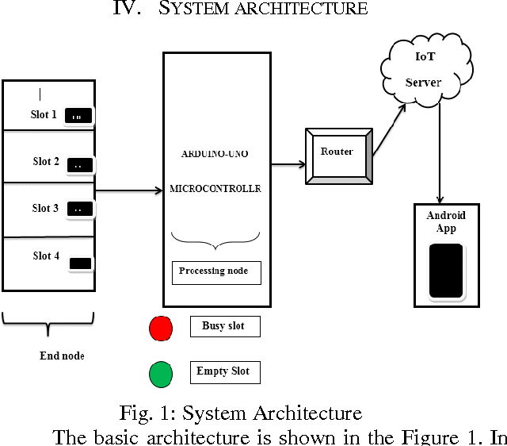
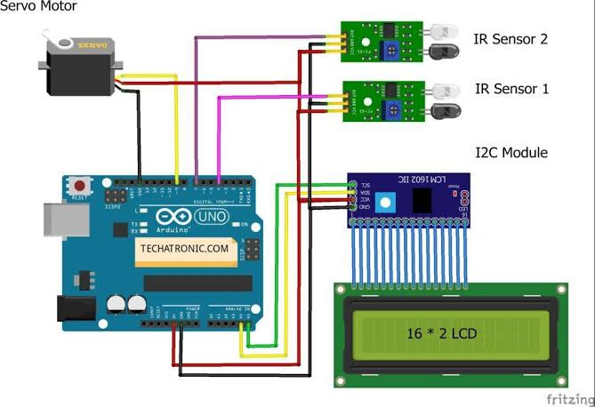
Diagram and Schematics:
Create a system architecture diagram showing how devices connect to the platform. Include schematics for the IoT devices' connectivity and power sources.

Slide 11
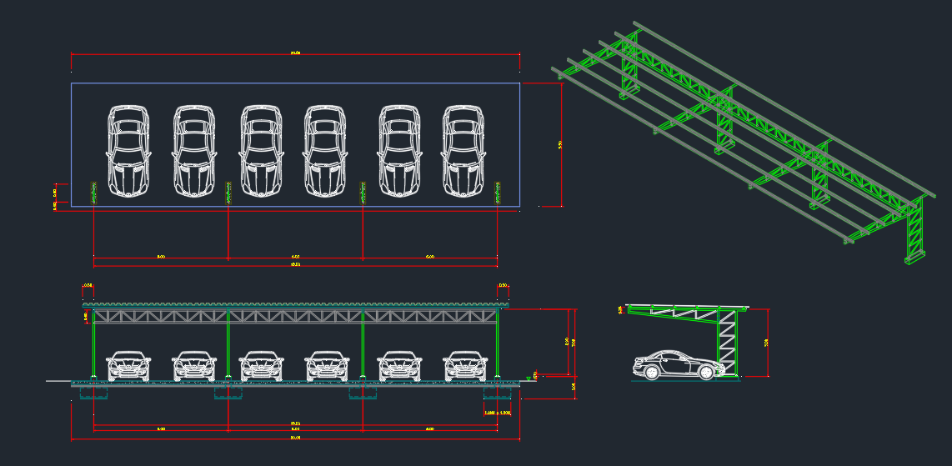
Public Toilet and Ceiling Plan Cad DWG Detail:

Slide 12
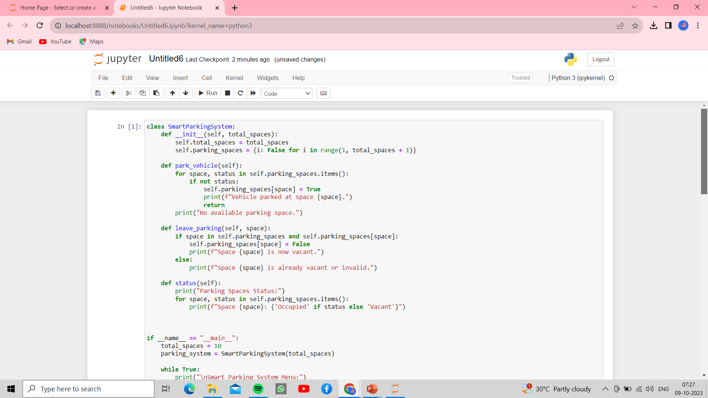
SCREENSHOT OF PYTHON CODE OUTPUT:

Slide 13
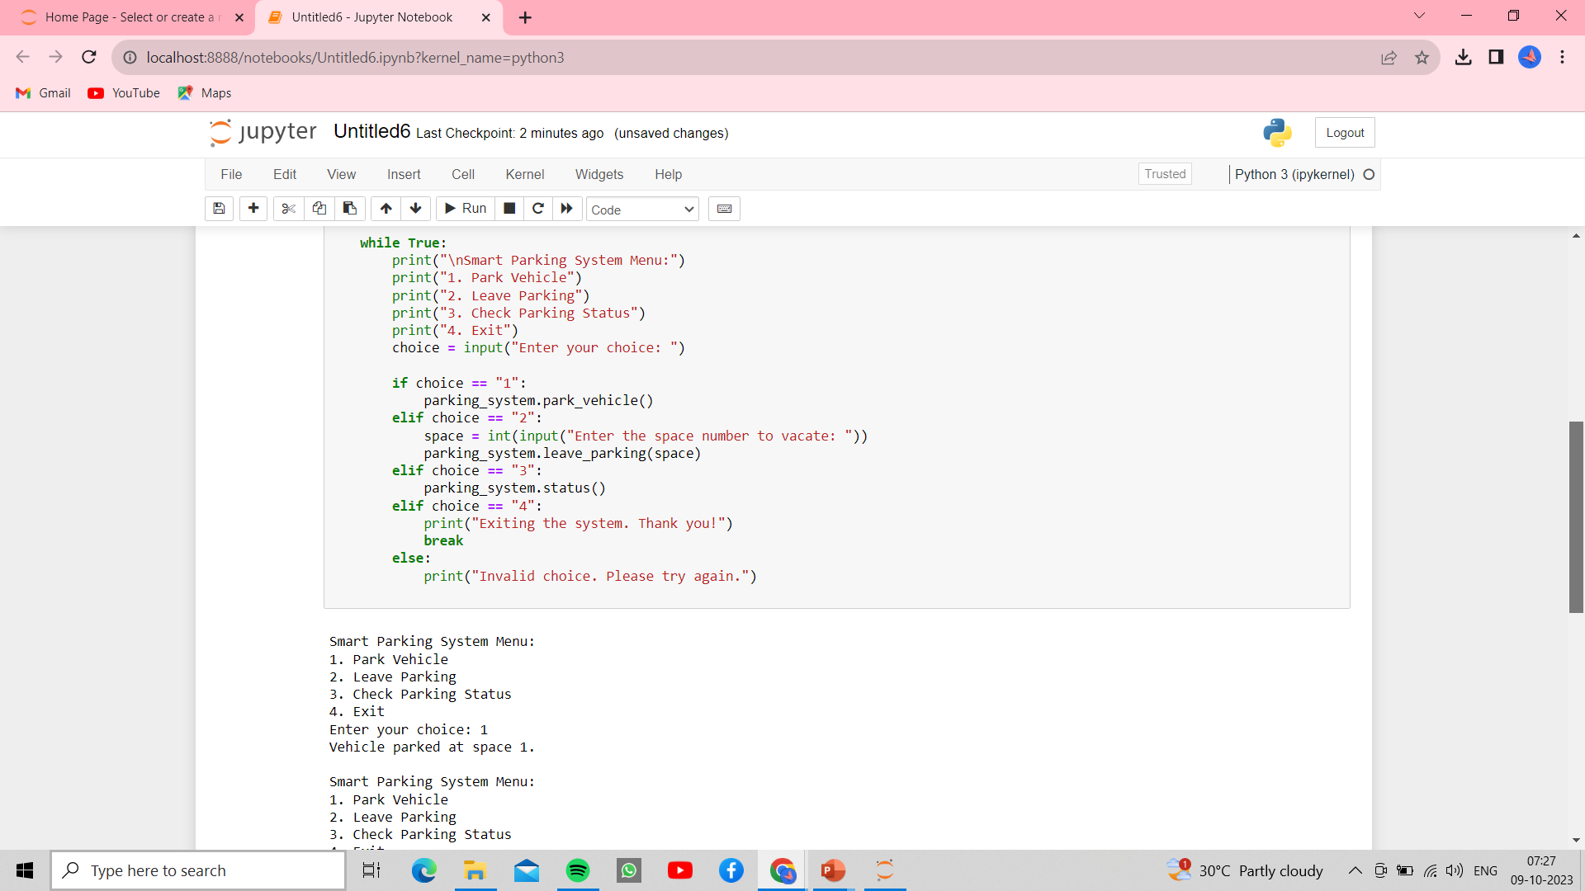

Slide 14
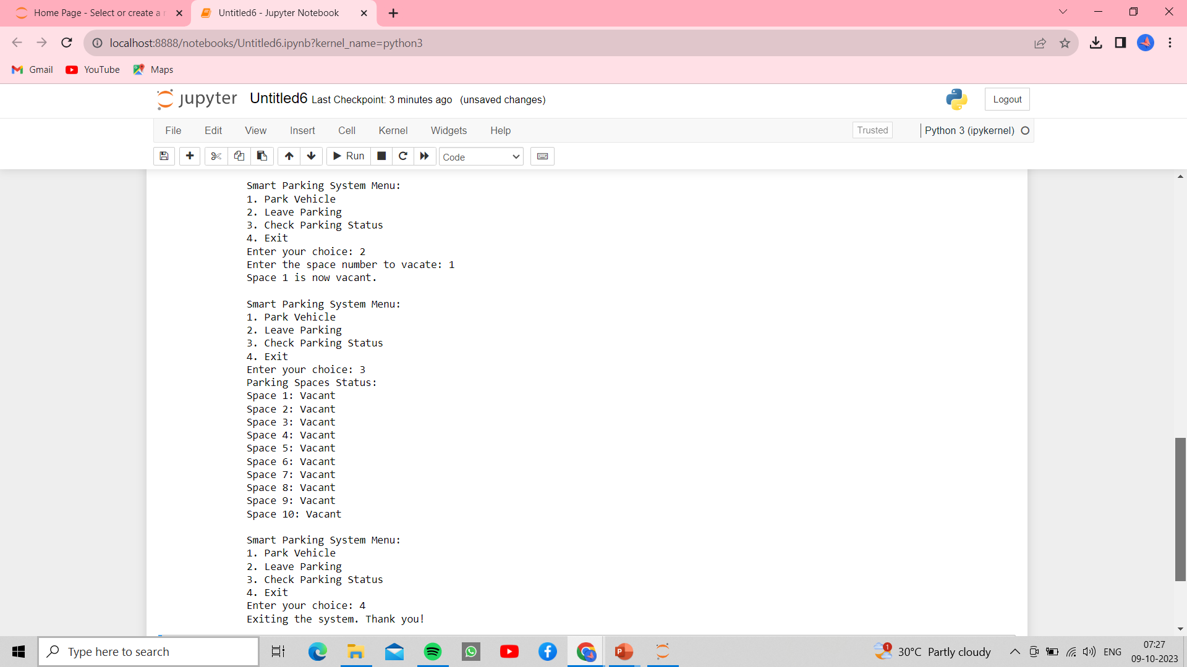

Slide 15
Conclusion:
The conclusion of a smart parking system is that it offers numerous benefits, including improved traffic management, reduced congestion, enhanced user convenience, and environmental advantages by reducing emissions. These systems leverage technology such as sensors, cameras, and mobile apps to optimize parking space utilization. However, successful implementation requires addressing technical challenges, privacy concerns, and affordability issues. Overall, smart parking holds great promise for more efficient urban transportation and urban planning.

Slide 16
Thank you

